Slide 1

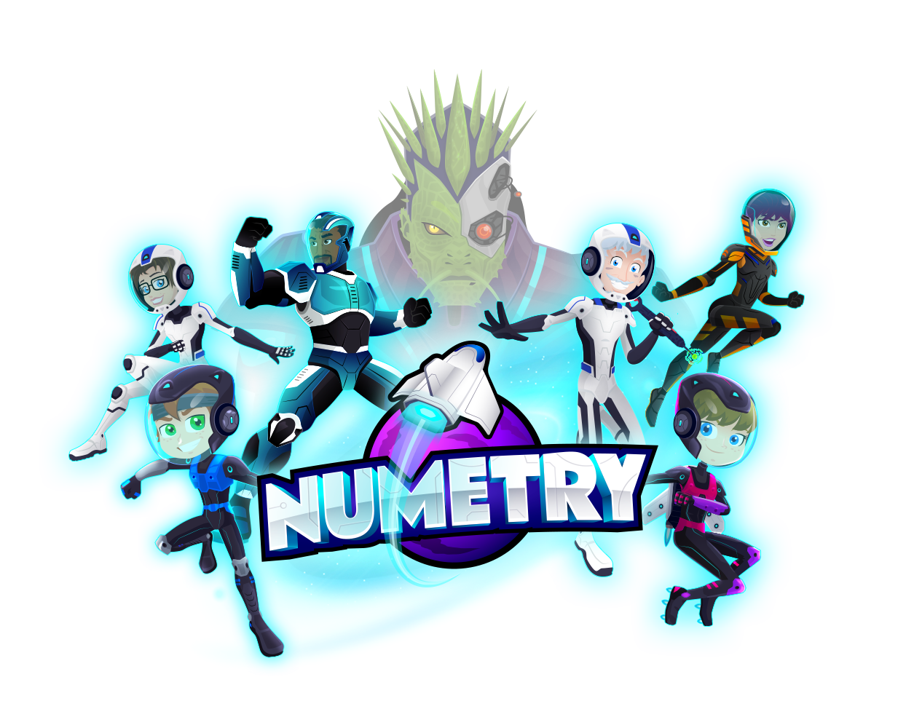

^{Play it. Learn it.}
^{Sondre Sandvoll} ^{Business Intern}
^{Presentation Noroff} ^{Bergen, Norway} ^{November 10, 2019}

Slide 2

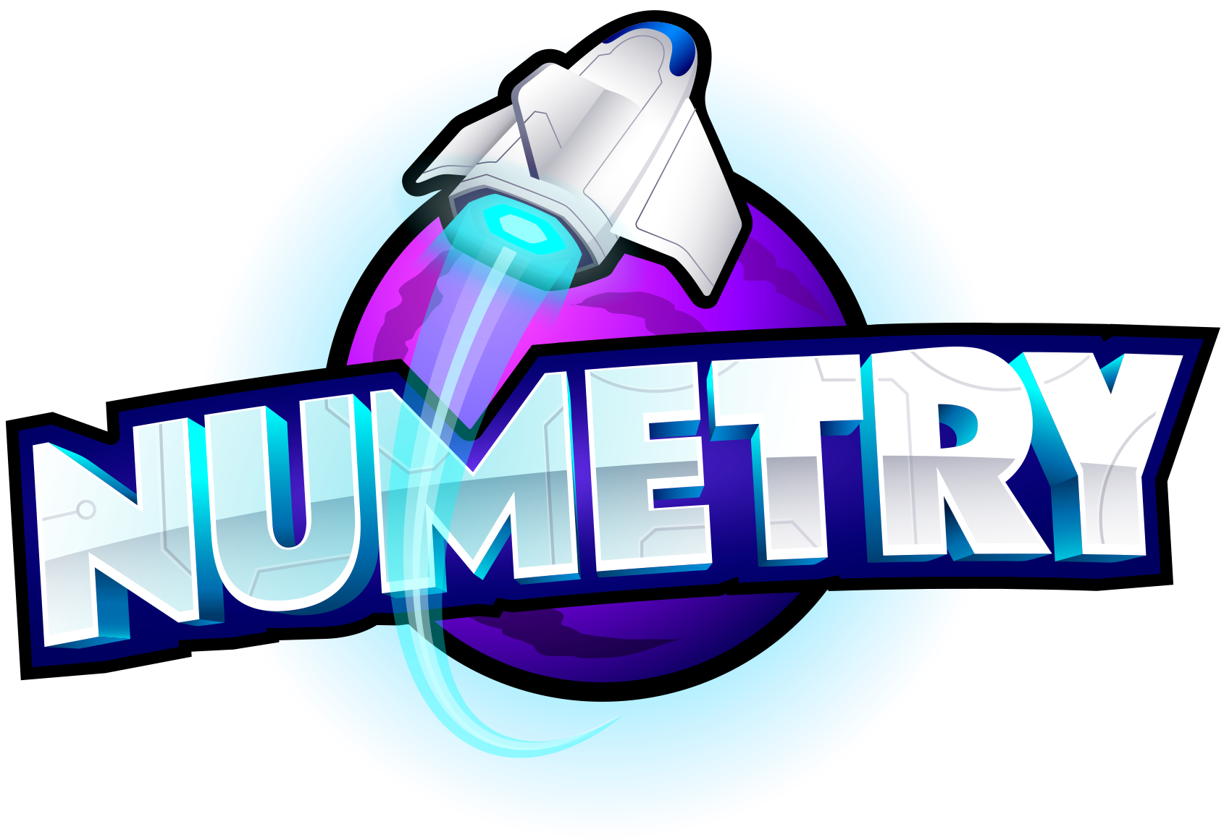
Problem
Too many children dislike mathematics and don't see the point of studying it. In a time where STEM subjects increasingly get more important, this is an obstacle that teachers are struggling with every day.

Slide 3

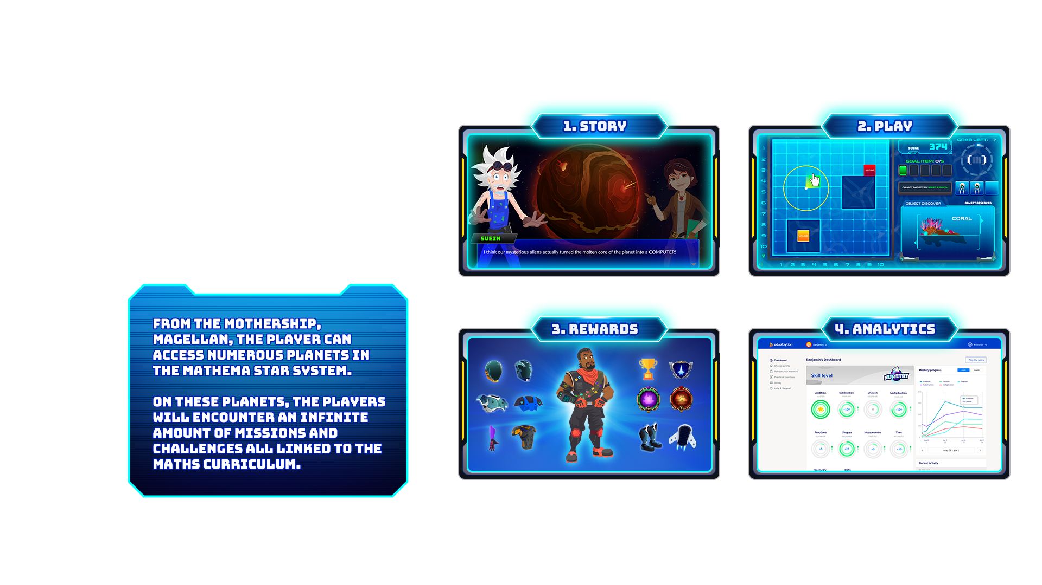
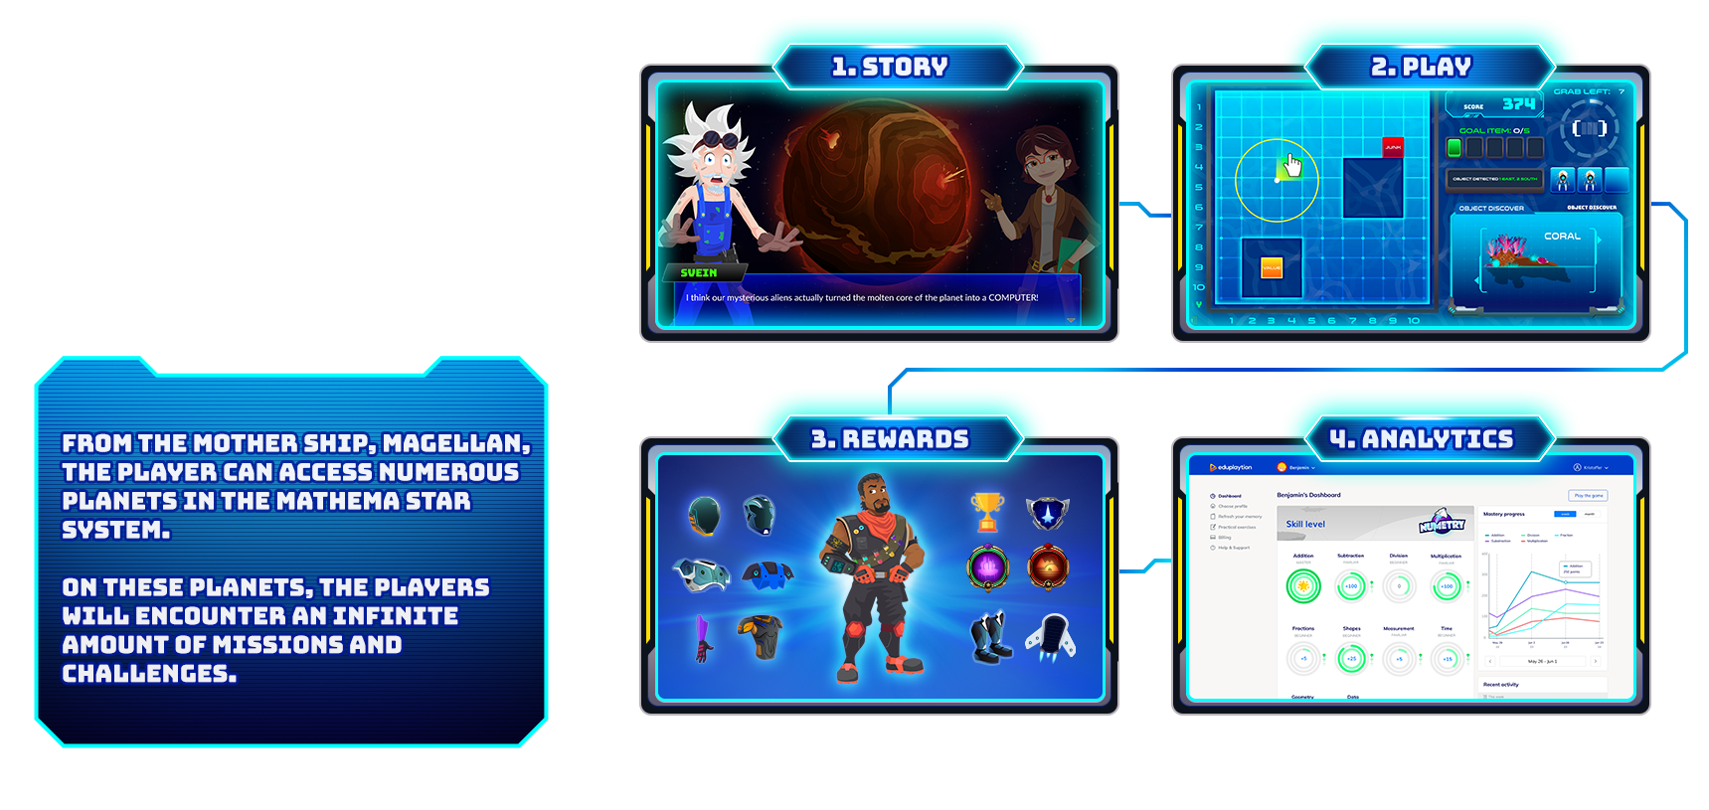

c
Numetry

Slide 4
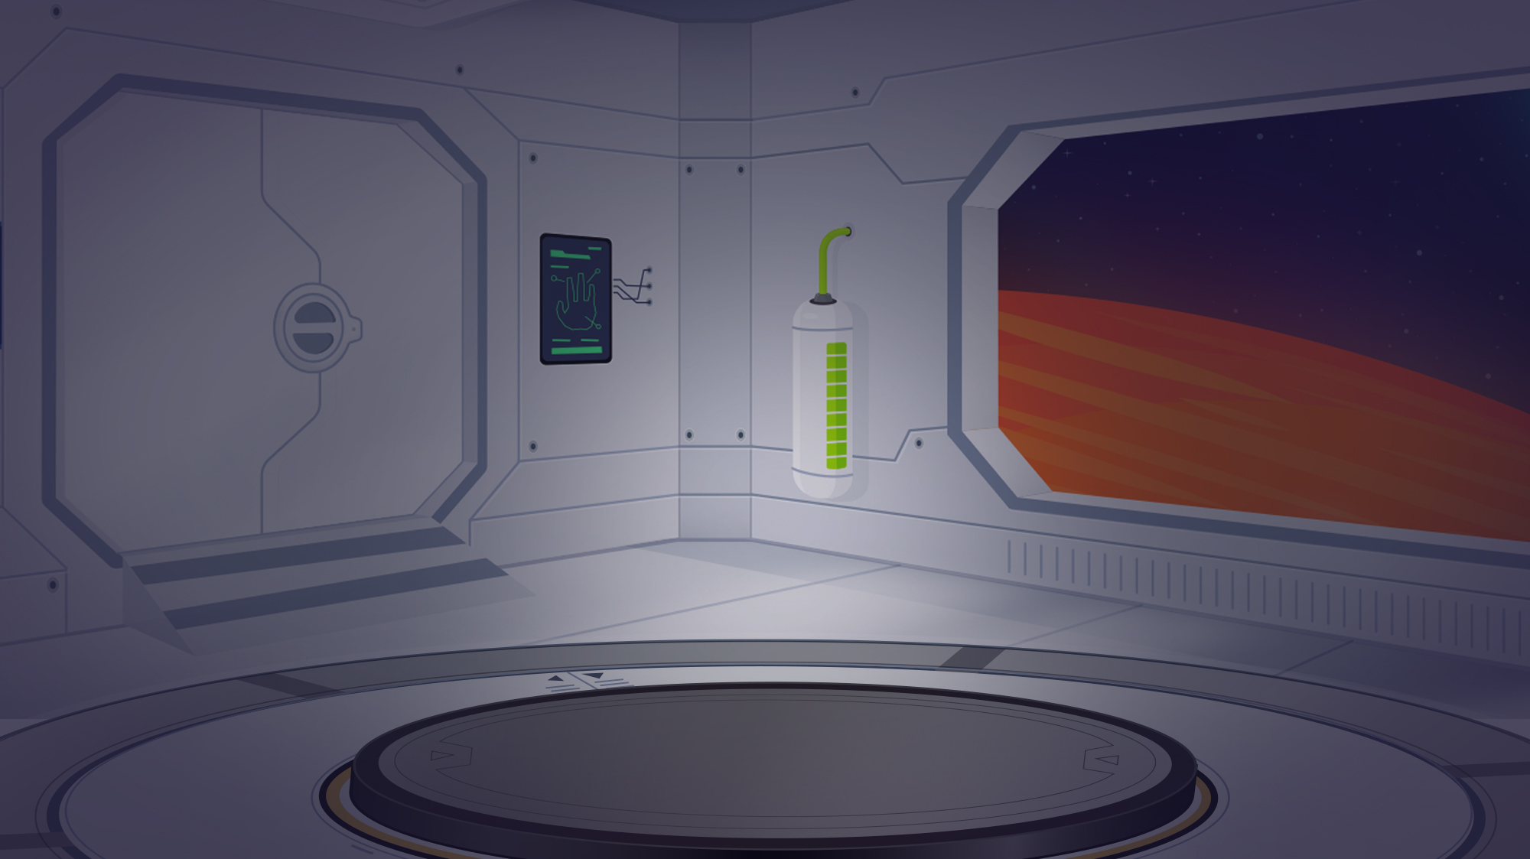
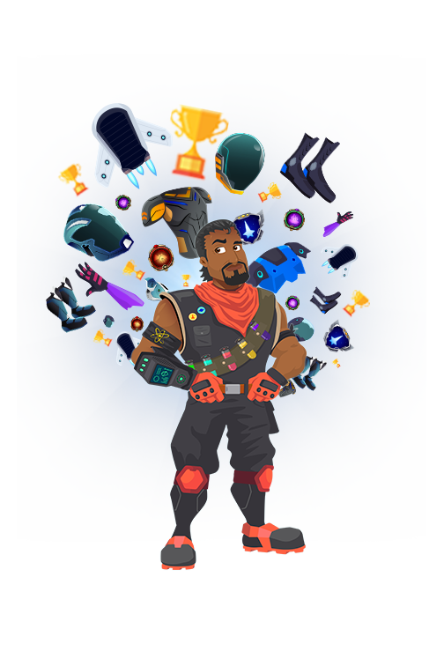
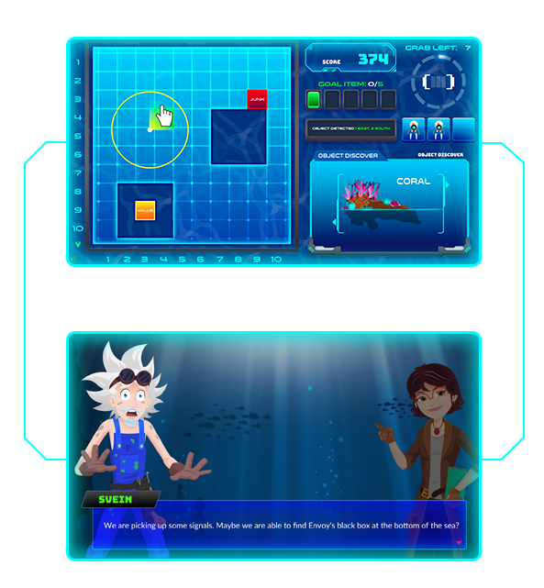
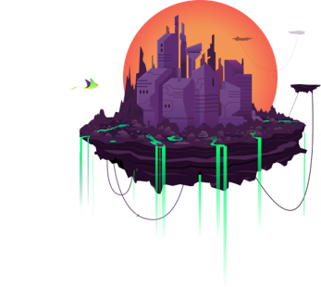
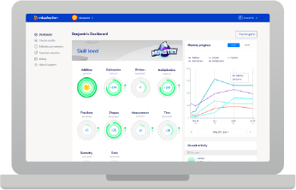
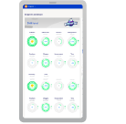
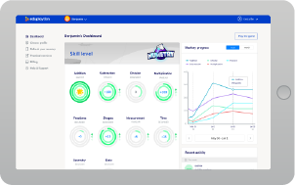
How We Make a Difference
1
2
3
4
^{Embodiment & Skins}
^{Engaging Story}
^{Relatable Missions}
^{Analytical Tool}

Slide 5
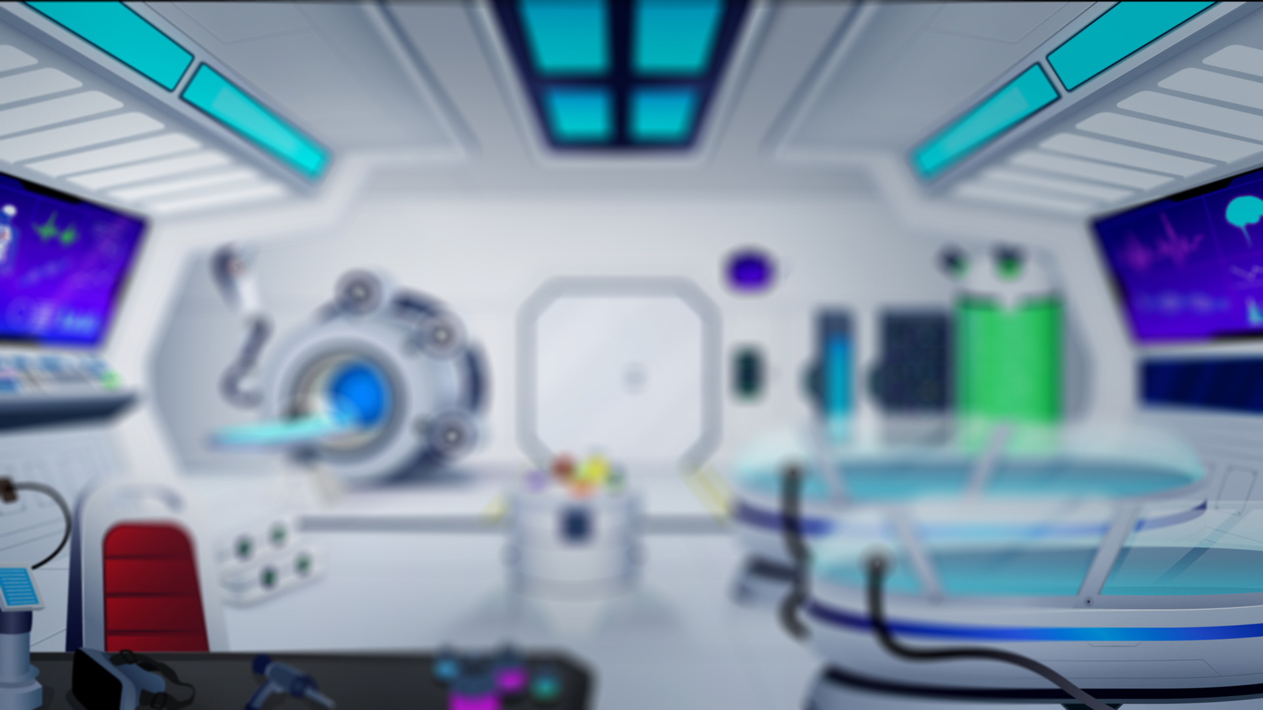




Business Model
^{Consumers & Schools}
^{Price Model}
^{Recurring Model}
^{Highly Scalable}
Parents are target buyers
However, we develop for school access from day one
We use the collaboration with schools to gain legitimacy
Once we create momentum in the consumer market, we will leverage this when approaching schools
Numetry will be free for everyone
Access to all the features, however, requires a premium account
NOK 89/month on the Monthly Plan, $ 6.49 USD/month on the Quarterly Plan, and $ 4.99 USD/month on the Yearly Plan.
The Premium plan will be offered as a subscription
We will constantly add new content for the players
Strong focus on smart cashier solutions, such as Vipps, PayPal or credit card to make payments pain-free
Numetry is built to scale
All technological decisions are made in order to rapidly create new content and customize the experience based on players’ feedback
Fast and cost-efficient localization
Virtually all code is reusable

Slide 6
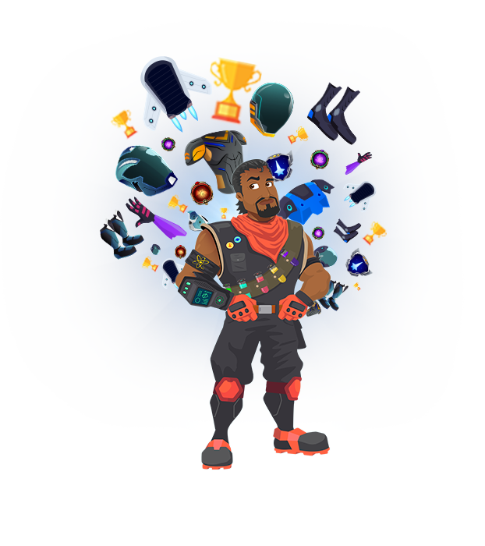

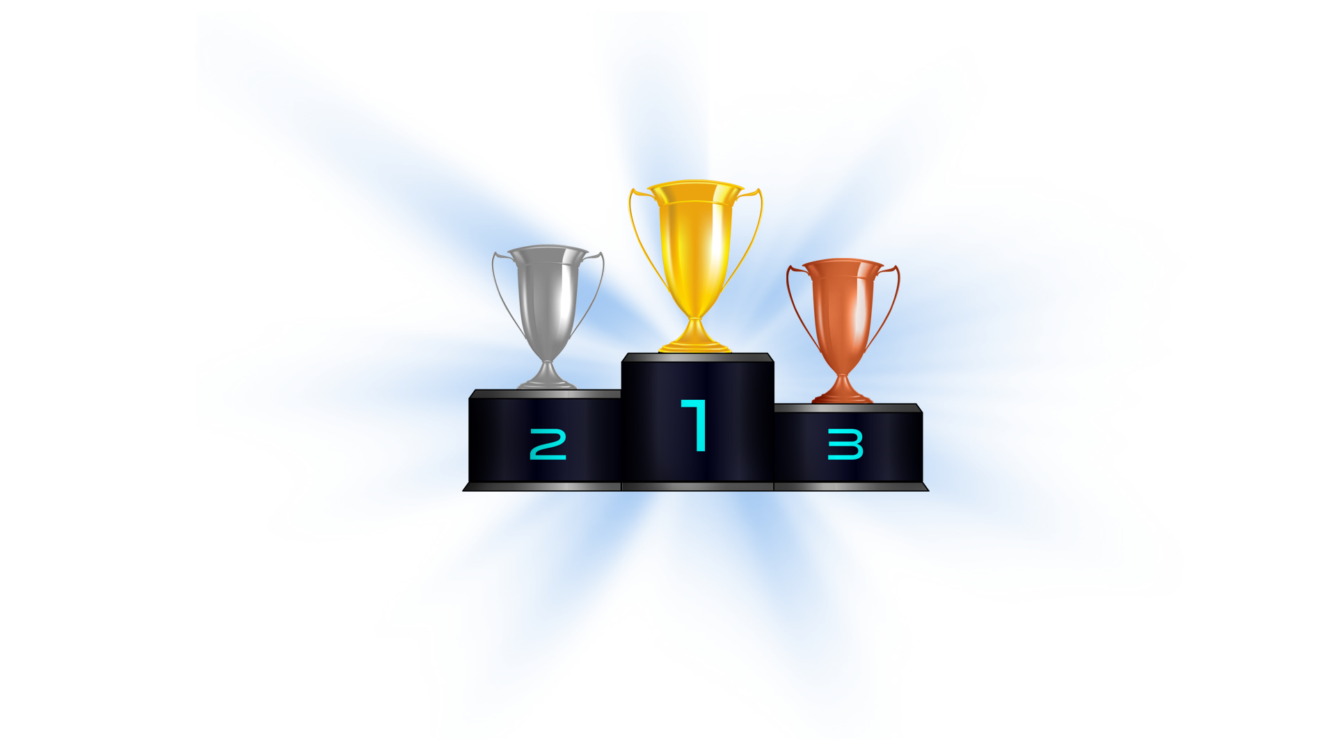
Why Go Premium
^{Level Up}
^{Ranking}
^{New Content}
^{Keep Up}
^{Why?}
^{Why?}
^{Why?}
^{Why?}
Kids love the prospect of being able to upgrade their characters – and of course having the coolest skins and decals amongst their peers. They can’t get enough of them! Kids today beg their parents to pay 20 USD to unlock a dance in the online game Fortnite.
We all love to beat our friends at something – and particularly kids. Today, most kids play with and against another kids from all over the world. With Numetry, we can harness that love of online playing to get kids to practice and master mathematics.
Whether it's daily quests or weekly challenges, kids love getting new content on a regular basis. We will create new content constantly so that our users always have something new to do in the world of Numetry.
Parents want to stay on top of their child's academic performance and growth, and with Numetry’s powerful analytical tool, they can. All of a student's progress is tracked, and our tools can point out any weak areas in the student's learning, so that teachers and parents can intervene in specific skills.

Slide 7

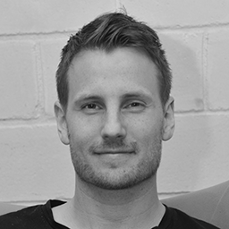


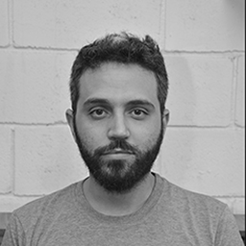
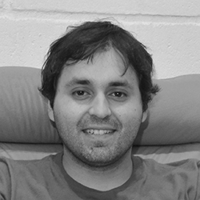
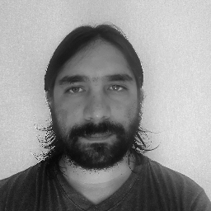



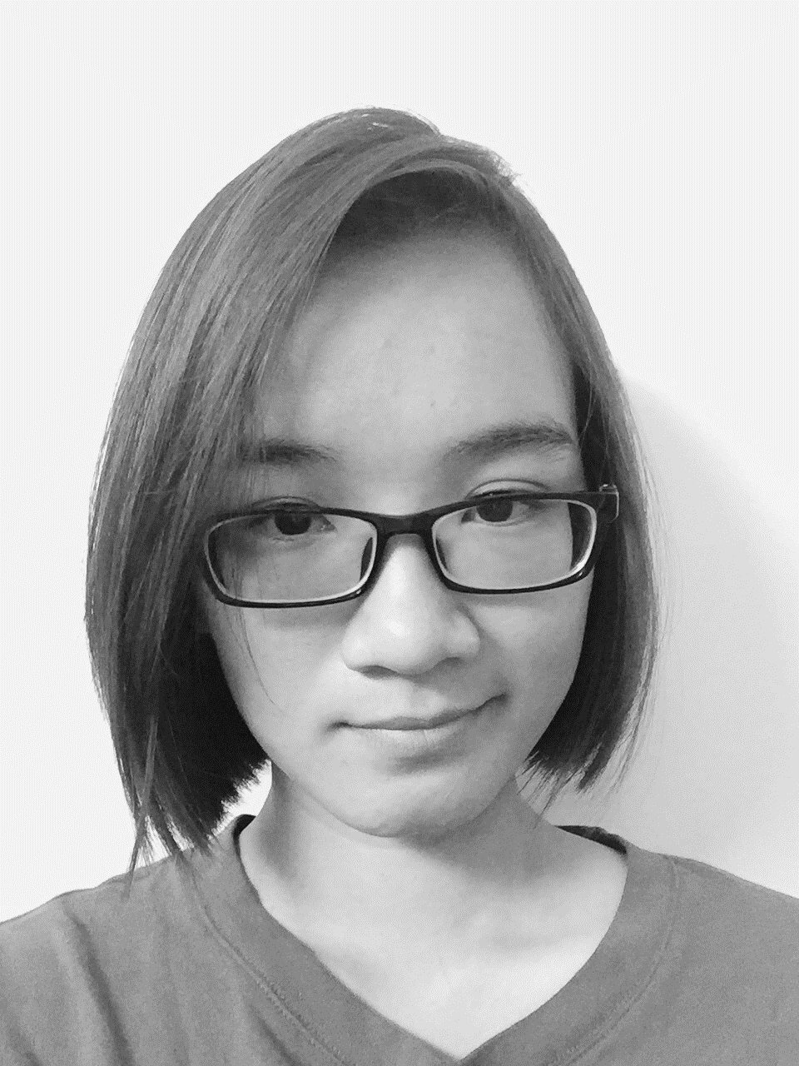
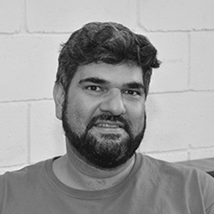
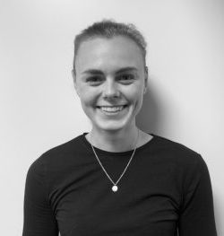
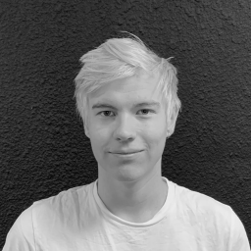

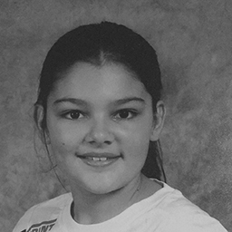
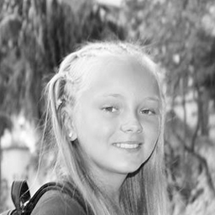
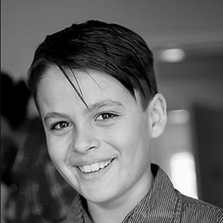
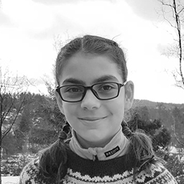

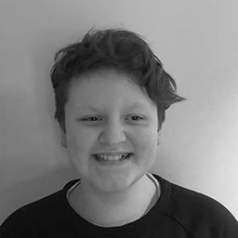

Crew
Founder & CEO Kristoffer Hundershagen (NO)
CTO Robert Madsen (US)
Lead Designer Patrick Holleman (US)
Lead Artist Alberto Alves (BR)
Game Developer Germán Barros (CH)
Game Developer Roberto Needham (CH)
Lead Pedagogue Endre Natvik (NO)
Pedagogue Håvard Tjora (NO)
Assessor Sverre Tveit (NO)
Illustration & UI Design Nhu Pham (US)
Illustration & Animation Mario Moura (BR)
Marketing Intern Rakel Ottesen (NO)
Videography Intern Ådne Olsen (NO)
Business Intern Sondre Sandvoll (NO)
+ experts
Leila 6th Grade
Ingrid 6th Grade
Gabriel 6th Grade
Edina 4th Grade
Brendon 8th Grade
Arve 6th Grade
Mahdi 6th Grade
Notes:
Leila-Linea 6. klasse; Ingrid 6. klasse; Gabriel 6. klasse, Edina 4. klasse; Brandon 8. klasse, Mahdi 6. klasse.

Slide 8




Go-to-Market Strategy
Distributed through App Store & Google Play
Significant media coverage
Uses parents and children when making promotional material
Sells a story of kids finally learning, and parents relieved
Spread through word of mouth
Inbound marketing
Distributed through the App Store & Google Play
Significant media coverage
Predominantly direct marketing
Distributed through App Store, Google Play and web
Free for teachers
Driven by student-to-student referrals
Direct & inbound marketing
Use our unique collaboration with schools as leverage
Web-based
Freemium and premium
Free access for teachers
Inbound marketing
Collaboration with relevant influencers and youtubers
In-game referral systems for children
Word of mouth and heavily community-based where we create a sense of ownership

Slide 9
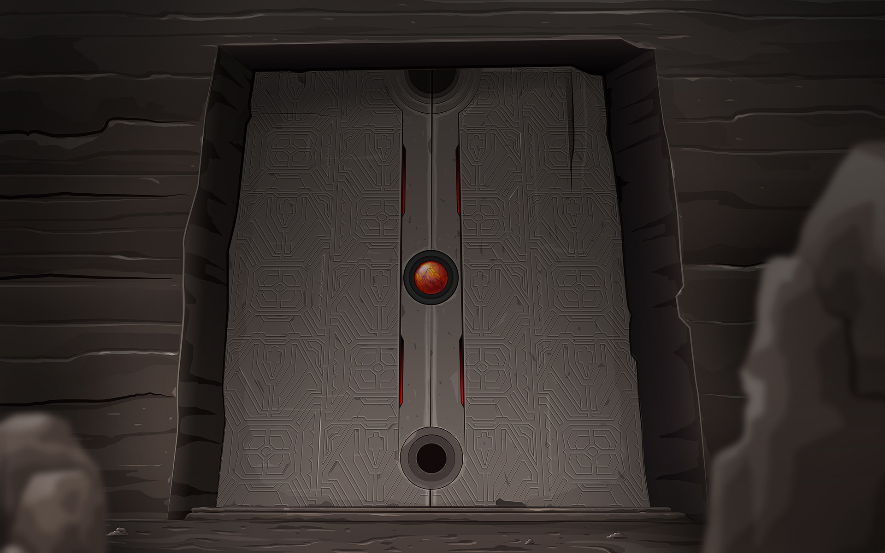
Case
Et av de viktigste kriteriene for foreldre når de kjøper læringsspill til barna, er at spillet må utstråle høy grad av kredibilitet. Matematikkspillet Numetry skal på den ene siden fremstå som spennende og morsomt for barna, og faglig og pedagogisk vanntett overfor foreldrene. Det er viktig at vi som aktører fremstår som en innovativ og solid aktør med et klart mål for øyet og som vet hva vi holder på med.
Vi behøver å tilpasse vår nettside slik at foreldrene blir overbevist til å prøve ut vårt spill. Spillet benytter seg av en freemium-løsning, så det skal i teorien ikke være noen hinder/risiko. Det er opp til oss å gjøre denne reisen så friksjonsfri og overbevisende som mulig, slik at vi får en så høy nettsidebesøk/freemium-prøving som mulig.

Slide 10

Let’s Do This
^{Spørsmål?}
^{Sondre Sandvoll}
^{Email: sondre@eduplaytion.no}
^{Phone: 94 800 642} ^{Read more: eduplaytion.no}

